Slide 1

Text Generation with Prompting & PLMs
( what I’ve learned during my M.S. Course )
Presenter: Eunchan Lee (Research Intern, UNIST)
UNIST Language & Intelligence Lab

Slide 2
Outline
Step 1: Text Generation ( Before & After GPT )
Step 2: GPT-3 & In-Context Learning (ICL)
Step 3: Prompting
Step 4: What makes ICL work?
Step 5: Variants of Prompting (Chain-of-Thought Prompting / Prompting for Multimodal)
Step 6: Limitations & Future Directions of Prompting

Slide 3
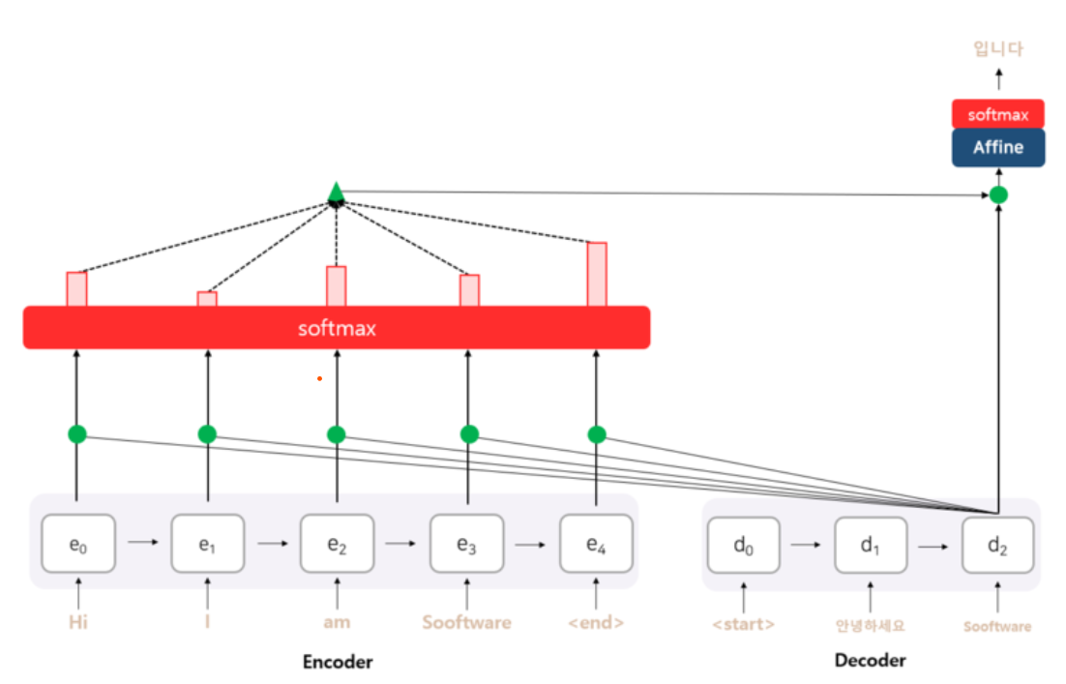
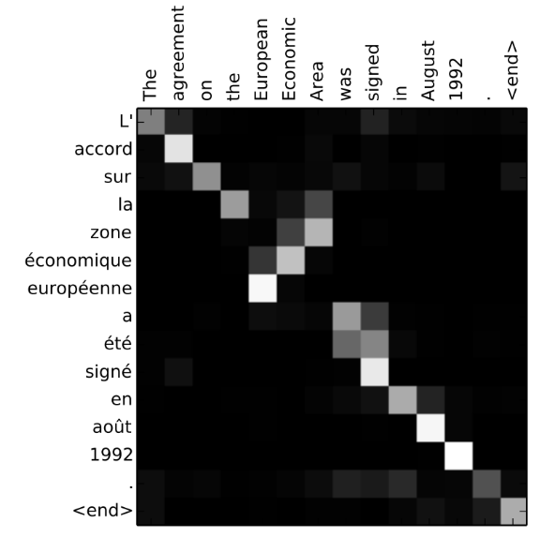
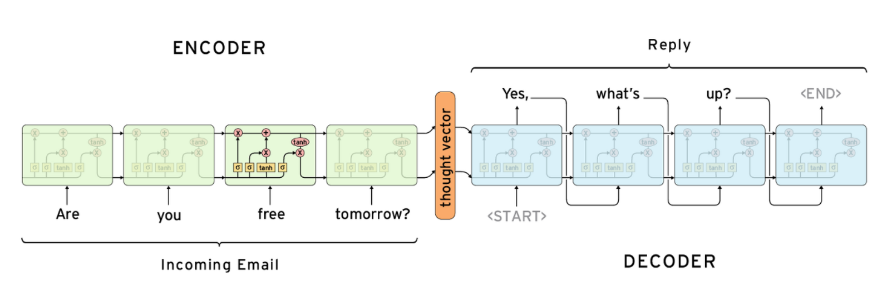
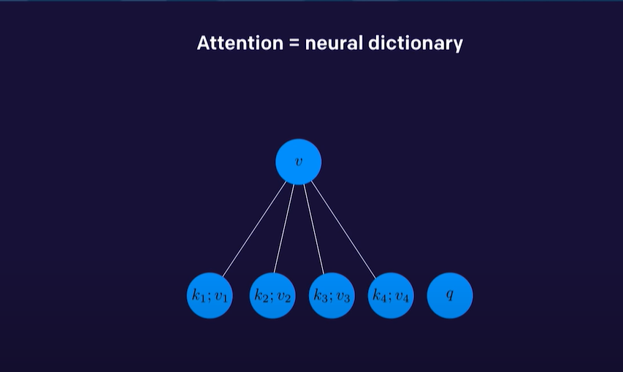
Text Generation ( Before GPT )
Attention mechanism & seq2seq ( via LSTMs ): Predicting the Next Word sufficiently well.
Figures from @sooftware & @aistudy9314(blog)

Slide 4
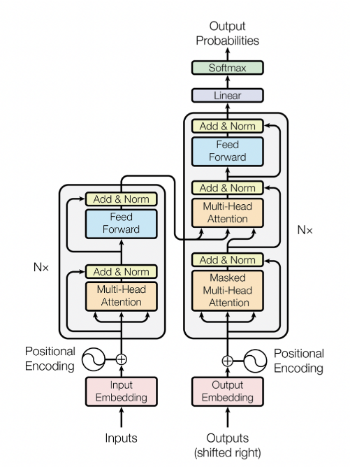
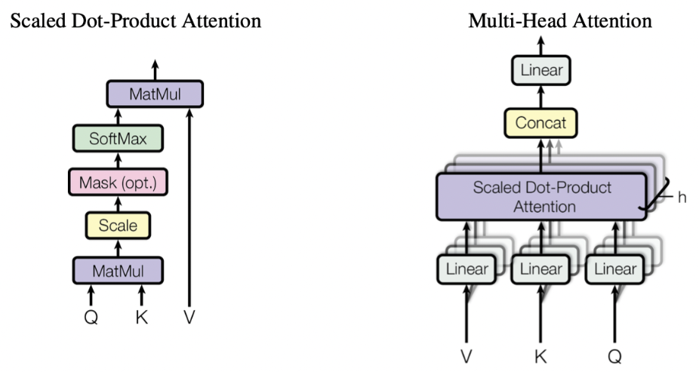
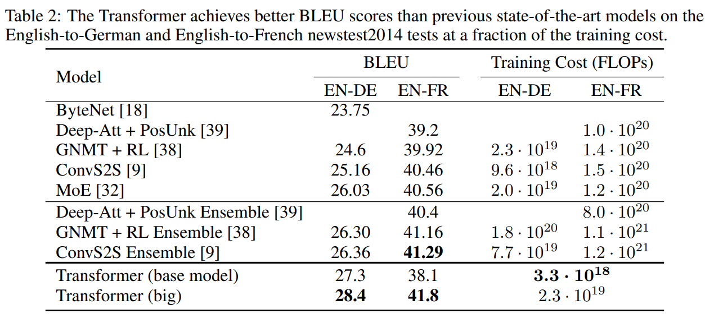
Text Generation ( Before GPT )
Attention mechanism & seq2seq ( via LSTMs ): Predicting the Next Word sufficiently well.
Transformer: improve seq2seq’s next word prediction by using only attention mechanisms.
Figures from @sooftware & @aistudy9314(blog)

Slide 5
Text Generation ( GPT )
Decoder-Only Block & Unsupervised Learning & Scaling Up: lead from Transformer to GPT-2 (2019)

Slide 6
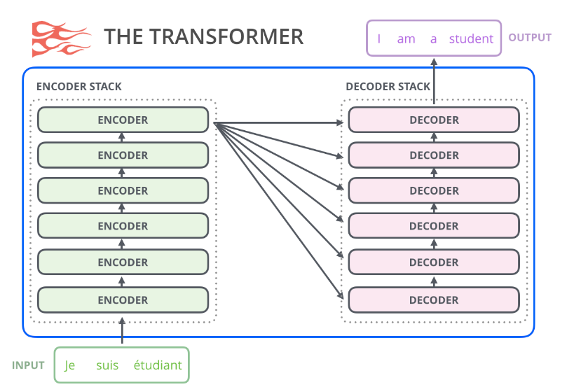
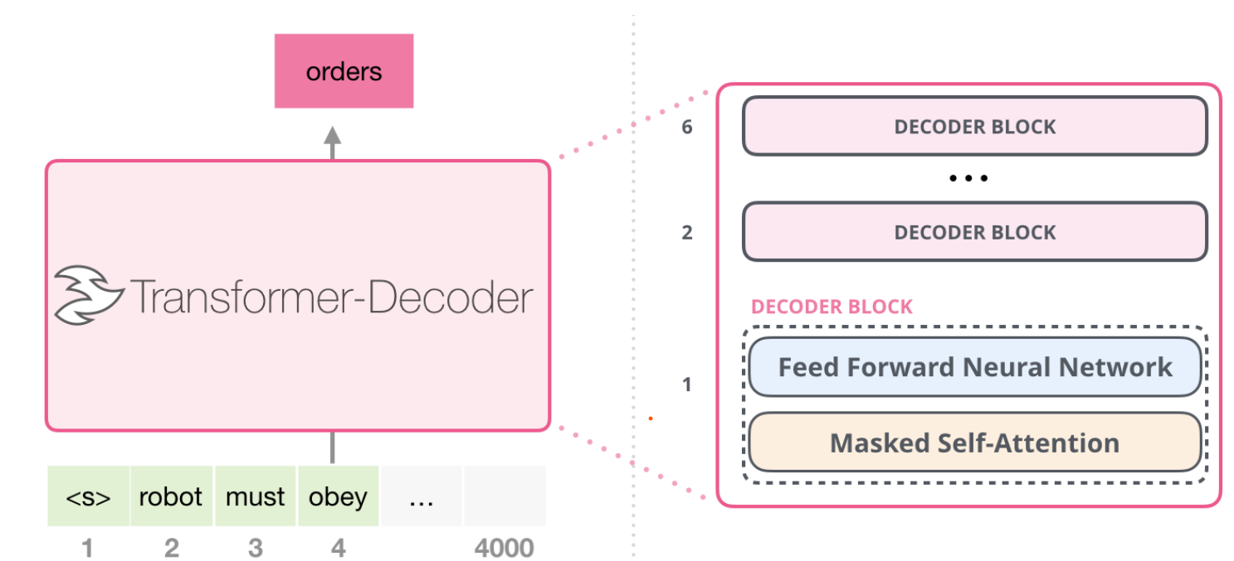
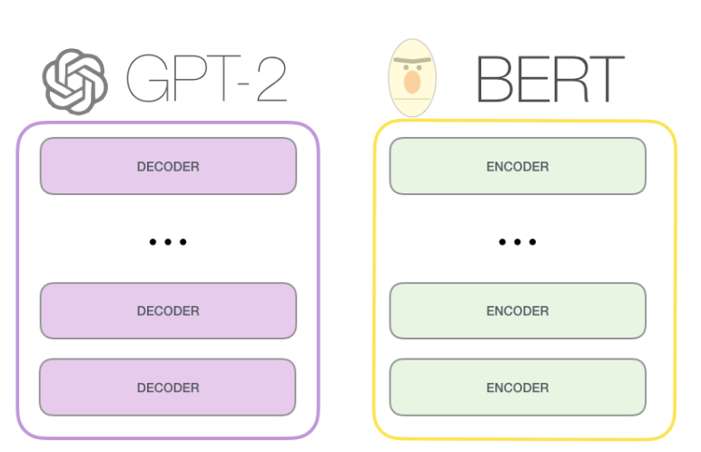
Text Generation ( GPT )
Decoder-Only Block & Unsupervised Learning & Scaling Up: lead from Transformer to GPT-2 (2019)
Encoder-Only → BERT (2019)
Decoder-Only → GPT-2 (2019)
Figures from @JayAlammar’s post
(If you interested in GPT-2, this post will help you.)

Slide 7
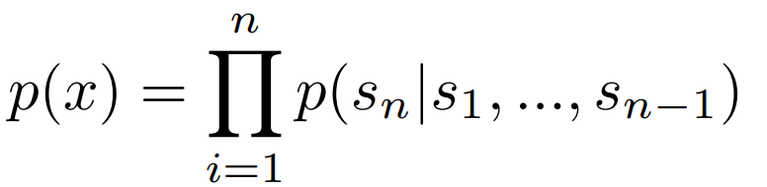
Text Generation ( GPT )
Decoder-Only Block & Unsupervised Learning & Scaling Up: lead from Transformer to GPT-2 (2019)
( dataset )
( Main point )
WebText = lots of variety
The Goal of GPT-2
(for unsupervised Pre-training)
Language Model that performs multitasks only through unsupervised pre-training without fine-tuning. (Zero-Shot)
From external links shared at least 3 times on Reddit
Human-annotated filtering
Deduplications (중복 제거작업)
40GB of text
Training Objective:
OpenAI trained GPT-2 with 100 Volta GPU (V100) for a week.

Slide 8
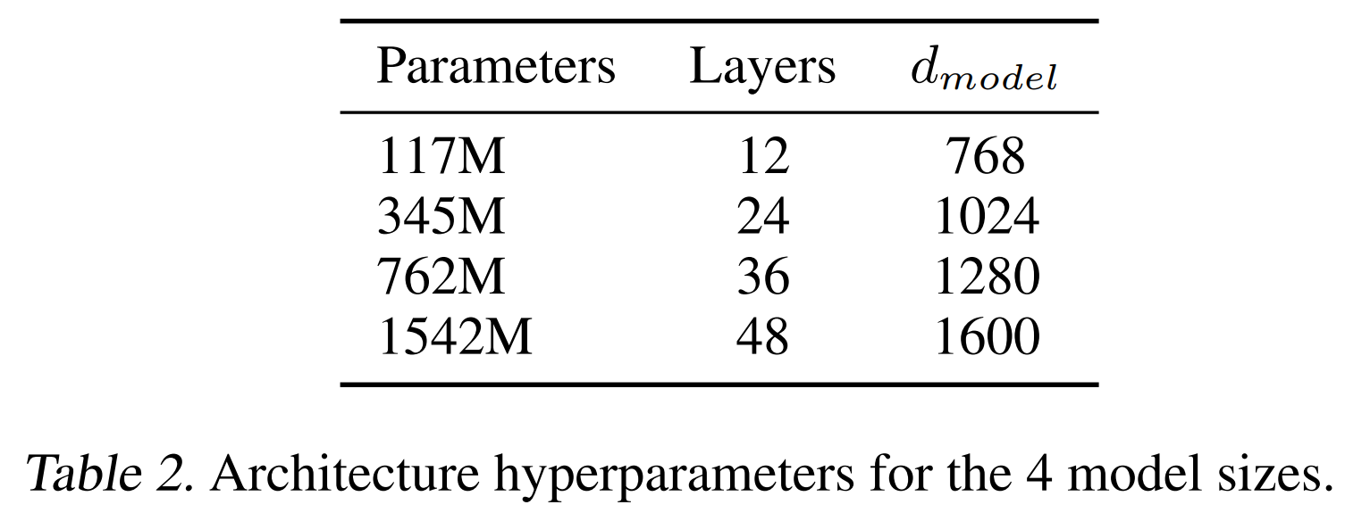
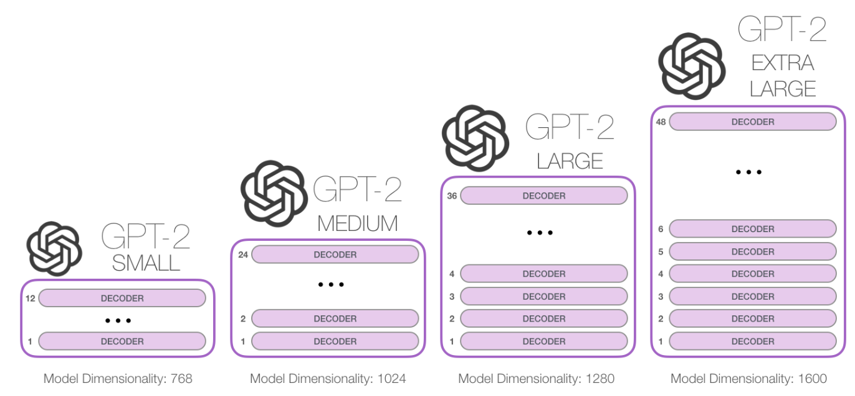
Text Generation ( GPT )
Decoder-Only Block & Unsupervised Learning & Scaling Up: lead from Transformer to GPT-2 (2019)
< GPT-2 >
Small (0.1B)
Medium (0.3B)
Large (0.76B)
XL (1.5B)
Figures from @JayAlammar’s post
(If you interested in GPT-2, this post will help you.)

Slide 9
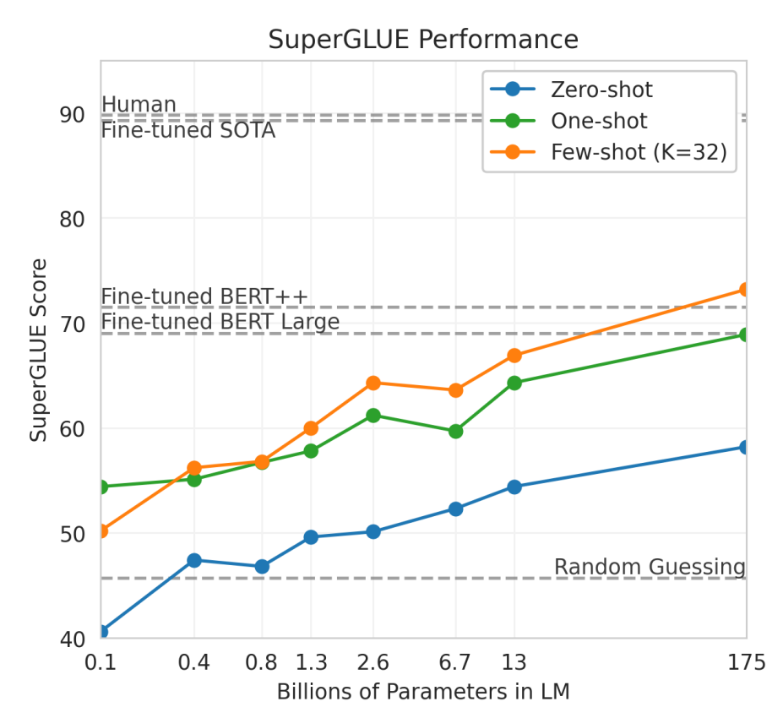
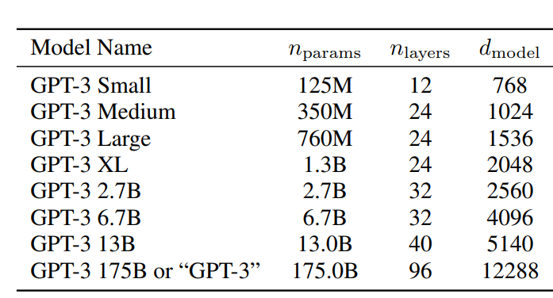
GPT-3 (2020)
▶Scale up to 175B
▶Language Models are Few-shot Learners
▶Can achieve strong performances on text understanding-based tasks using few-shot left-to-right text generation.
< GPT-2 >
Figures from @GPT-3_PAPER

Slide 10
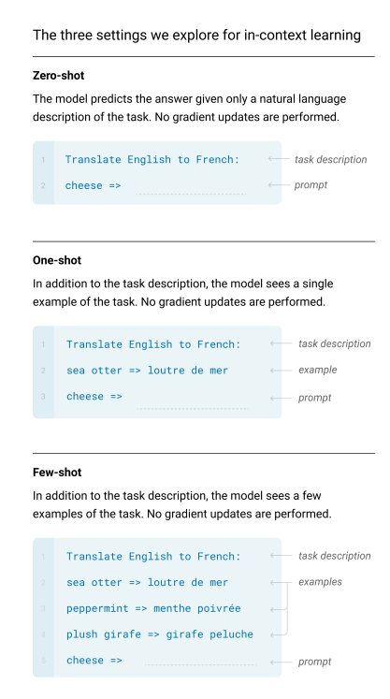
In-context Learning (GPT3; Brown et al., 2020)
By using ‘Prompting’, GPT3 performs learning w/o gradient updates!
For all tasks, GPT-3 is applied without any gradient updates or fine-tuning, with tasks and few-shot demonstrations specified purely via text interaction with the model.(=prompting)
Use case: Configure text input like a blue box (left) to generate right task answers.

Slide 11
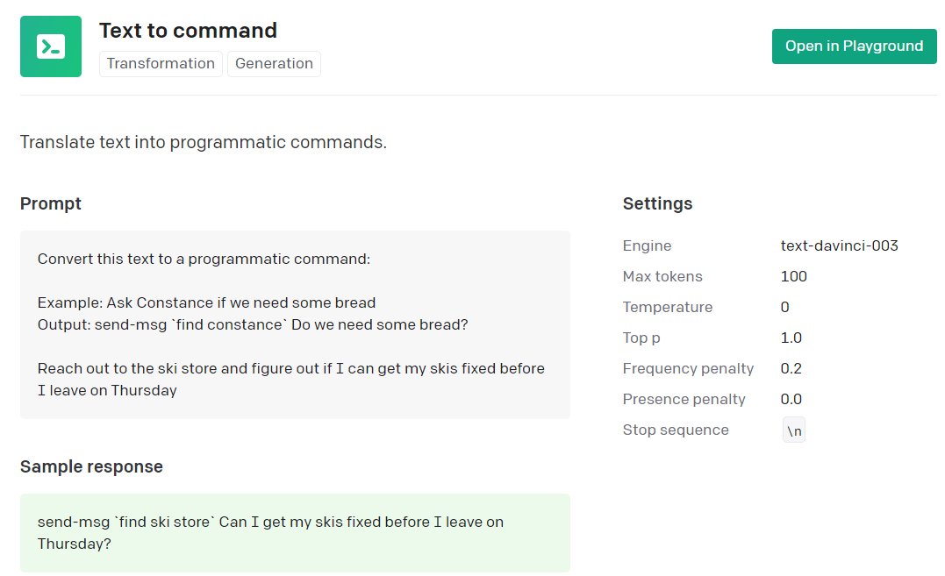
GPT’s Prompting Example
▶GPT’s Prompting = Task description + example of data (zero-, one-, few-shot)
= One-shot Prompt
( GPT-3 175B based )

Slide 12
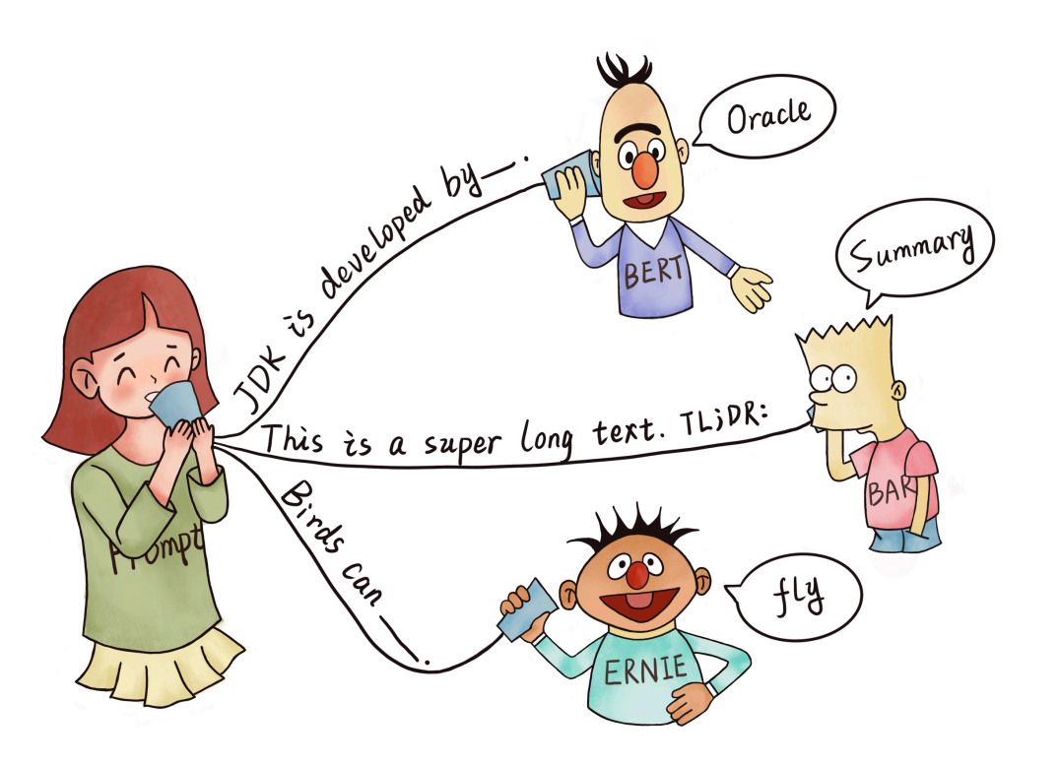
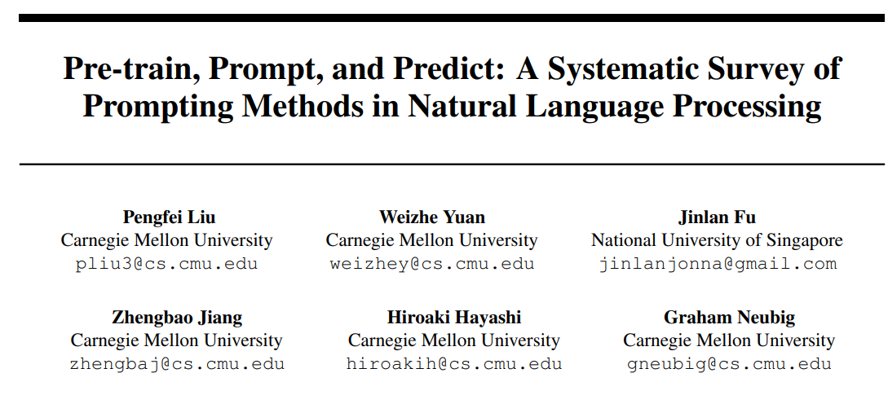
What is Prompting?
prompt-based learning is based on language models that model the probability of text directly. To use these models to perform prediction tasks, the original input x is modified using a template into a textual string prompt x 0 that has some unfilled slots, and then the language model is used to probabilistically fill the unfilled information to obtain a final string xˆ, from which the final output y can be derived. This framework is powerful and attractive for a number of reasons: it allows the language model to be pre-trained on massive amounts of raw text, and by defining a new prompting function the model is able to perform few-shot or even zero-shot learning, adapting to new scenarios with few or no labeled data.
▶Prompting is like a sort of interacting with the model with text-direction. It basically aims to few-shot or zero-shot with Large (Pretrained) LMs.
Pre-train, Prompt, and Predict: A Systematic Survey of Prompting Methods in Natural Language Processing { 2021, Liu et al. (Carnegie Mellon University) }

Slide 13
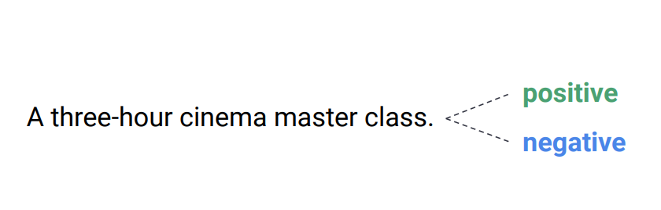
A simple example of Prompting
( ▶Perform the task w/o fine-tuning. How does it work? )
For example, let’s say we consider sentiment analysis on movie review.
Figures from @ACL22Tutorial

Slide 14
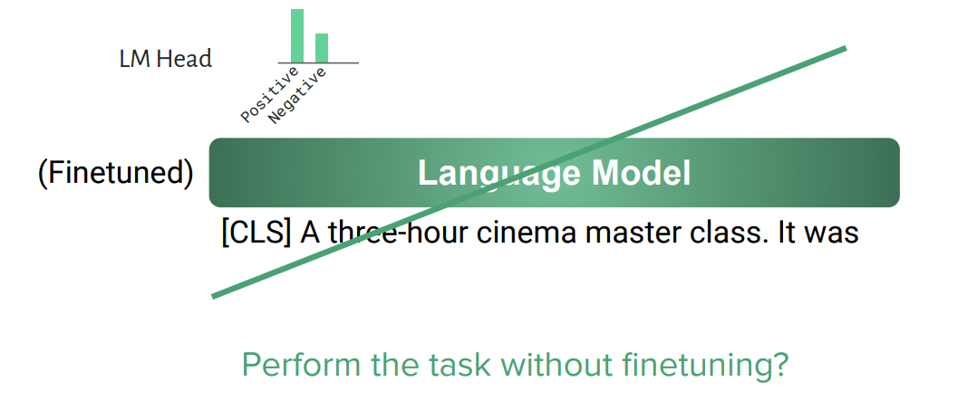
A simple example of Prompting
( ▶Perform the task w/o fine-tuning. How does it work? )
For example, let’s say we consider sentiment analysis on movie review.
Figures from @ACL22Tutorial

Slide 15
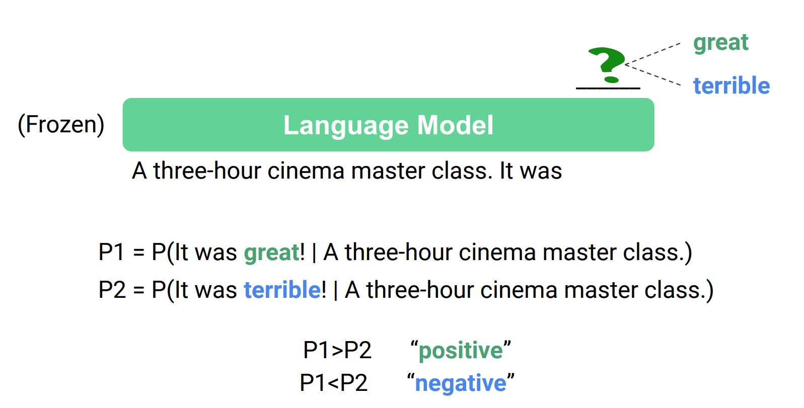
A simple example of Prompting
( ▶Perform the task w/o fine-tuning. How does it work? )
For example, let’s say we consider sentiment analysis on movie review.
Figures from @ACL22Tutorial

Slide 16
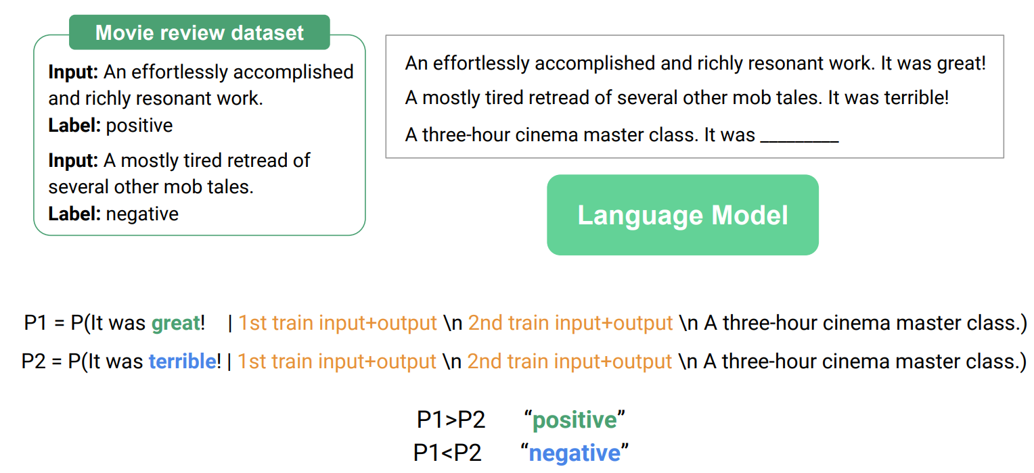
In-Context Learning
Figures from @ACL22Tutorial

Slide 17
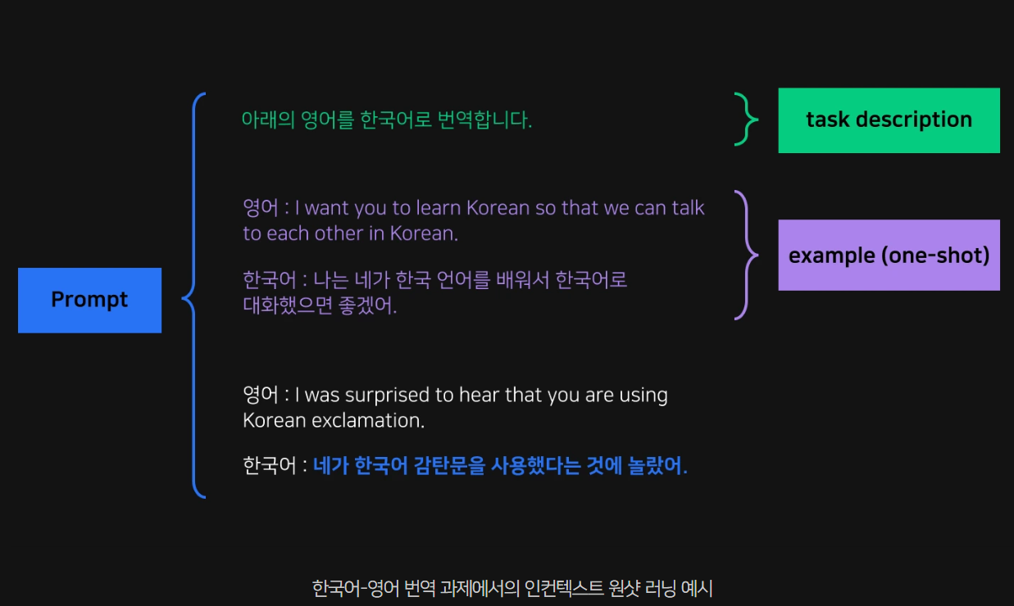
A nice example of In-Context Learning
▶A nice example of in-context learning for English→Korean neural machine translation
Few-shot Machine translation (English to Korean )

Slide 18
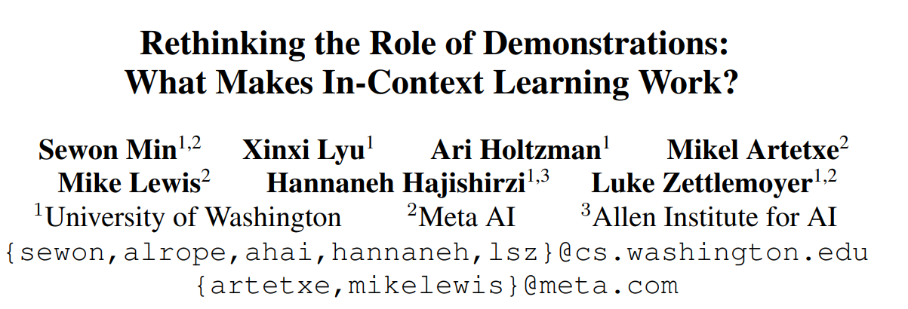
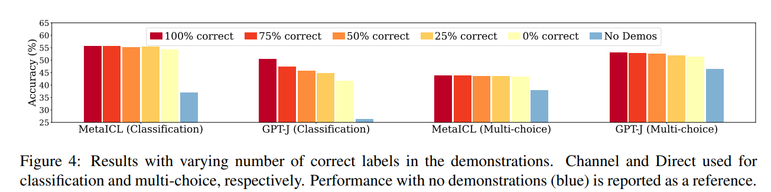
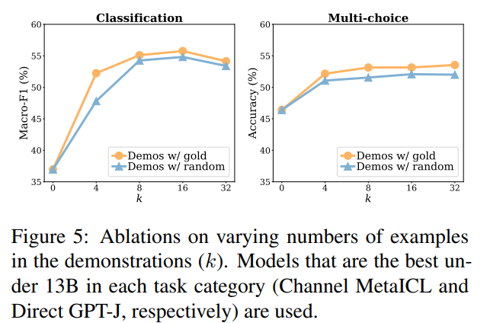
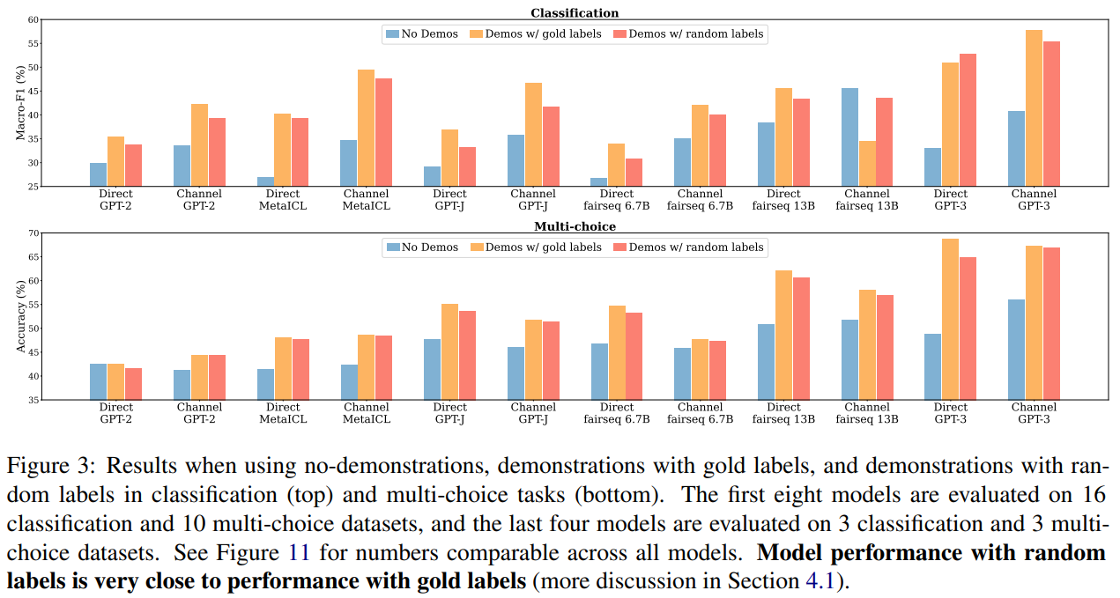
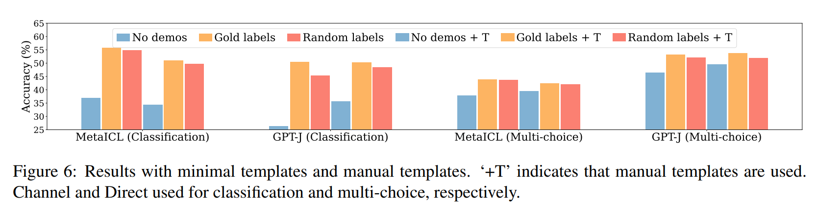
What makes ICL work? (EMNLP’ 22)
In order to what makes in-context learning work, they performed various factor analyses as shown below. (Used two LLMs: GPT-J, MetaICL)
Rethinking the Role of Demonstrations: What Makes In-Context Learning Work? (2022, Min et al.)

Slide 19
What makes ICL work? (EMNLP’ 22)
They performed various factor analyses.
Does the model learn at test time(=in-context learning)?
If we take a strict definition of learning: capturing the input label correspondence given in the training data, then our findings suggest that LMs do not learn new tasks at test time.
Our analysis shows that the model may ignore the task defined by the demonstrations and instead use prior from pretraining.
However, learning a new task can be interpreted more broadly: it may include adapting to specific input and label distributions and the format suggested by the demonstrations, and ultimately getting to make a prediction more accurately. With this definition of learning, the model does learn the task from the demonstrations.
The model adapts to make predictions more accurate, but does not learn new tasks at test time.
Rethinking the Role of Demonstrations: What Makes In-Context Learning Work? (2022, Min et al.)

Slide 20
What makes ICL work? (EMNLP’ 22)
They performed various factor analyses.
Capacity of LMs
The model performs a downstream task without relying on the input-label correspondence from the demonstrations.
This suggests that the model has learned the (implicit notion of) input-label correspondence from the language modeling objective alone, e.g., associating a positive review with the word ‘positive’.
This is in line with Reynolds and McDonell (2021) who claim that the demonstrations are for task location and the intrinsic ability to perform the task is obtained at pretraining time.
Demonstrations are for task location and the intrinsic ability to perform the task is obtained at pretraining time.
Rethinking the Role of Demonstrations: What Makes In-Context Learning Work? (2022, Min et al.)

Slide 21
How/Why in-context learning works?
Demonstrations do not teach a new task; instead, it is about locating an already-learned task during pretraining (Reynolds & McDonell, 2021)
LMs do not exactly understand the meaning of their prompt (Webson & Pavlick, 2021)
Demonstrations are about providing a latent concept so that LM generates coherent next tokens (Xie et al. 2022)
In-context learning performance is highly correlated with term frequencies during pretraining (Razeghi et al. 2022)
LMs do not need input-label mapping in demonstrations, instead, it uses the specification of the input & label distribution separately (Min et al. 2022)
Data properties lead to the emergence of few-shot learning (burstiness, long-tailedness, many-to-one or one-to-many mappings, a Zipfian distribution) (Chan et al. 2022)

Slide 22
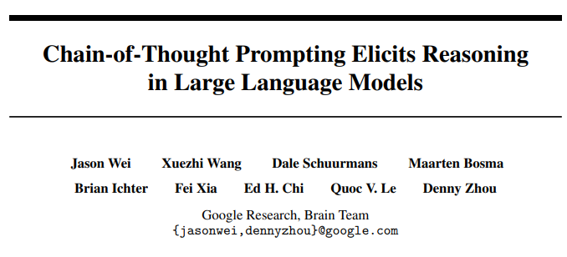
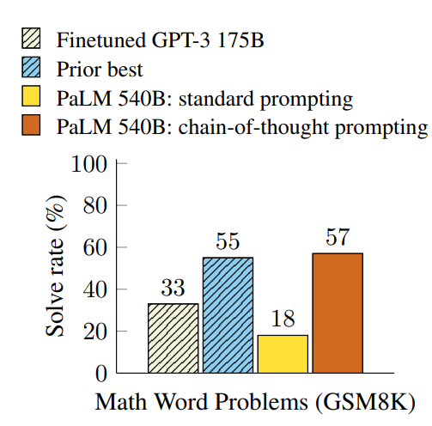
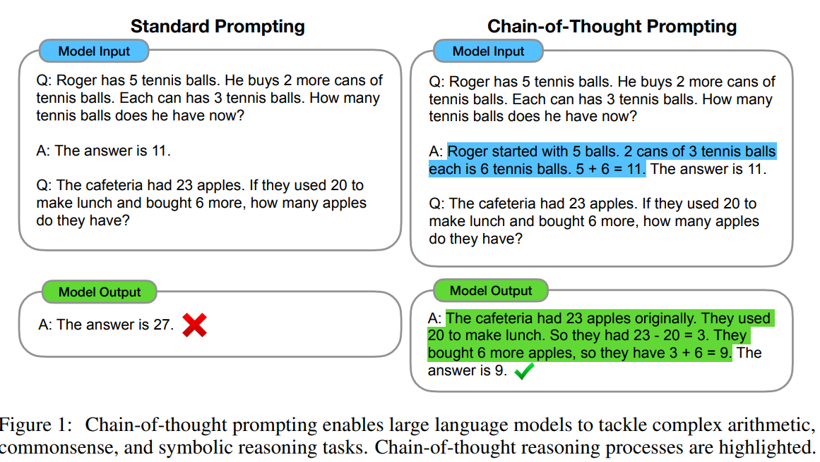
Chain-of-Thought Prompting (NeurIPS’ 22)
( A variant of Prompting, more improved. )
a few chain of thought demonstrations are provided as exemplars in prompting.
https://arxiv.org/abs/2201.11903

Slide 23
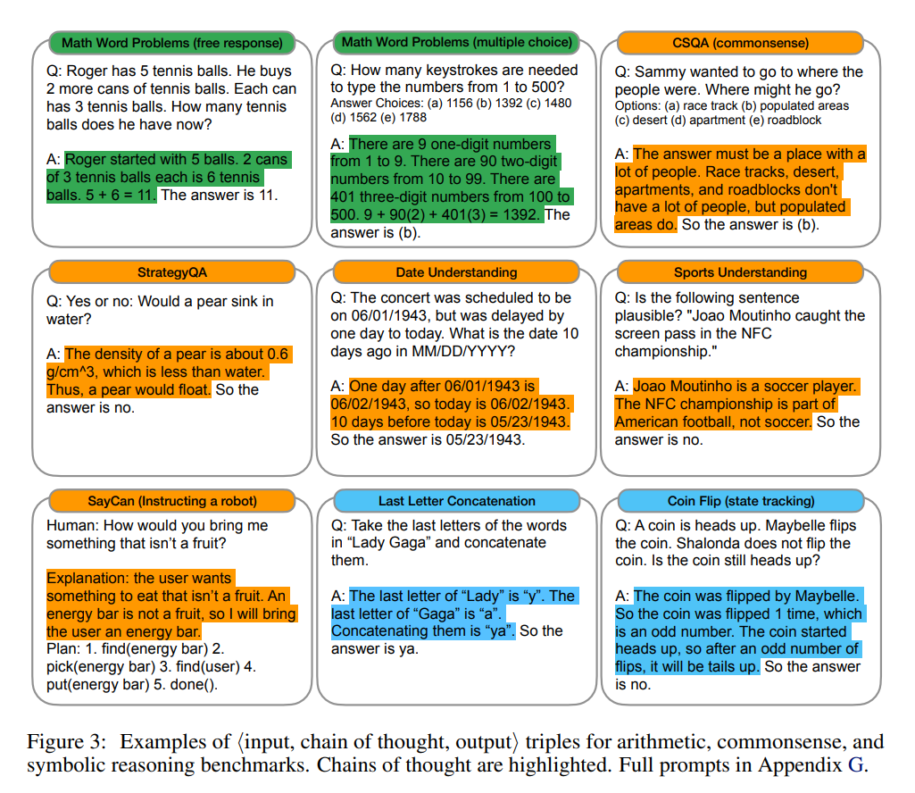
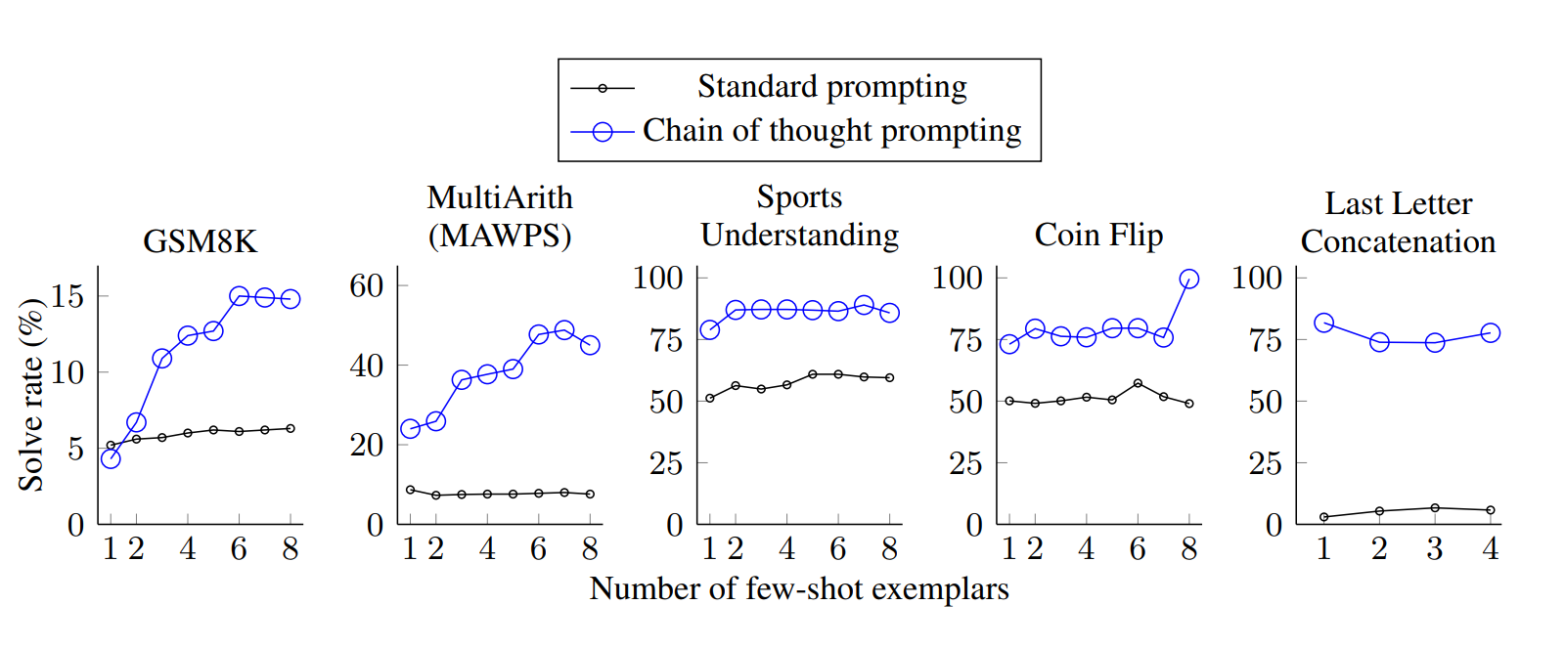
Chain-of-Thought Prompting (NeurIPS’ 22)
( A variant of Prompting, more improved. )
Task-specific Chain-of-Thought Prompting also improves the task accuracy. (e.g. Reasoning Coin Flip)
https://arxiv.org/abs/2201.11903

Slide 24
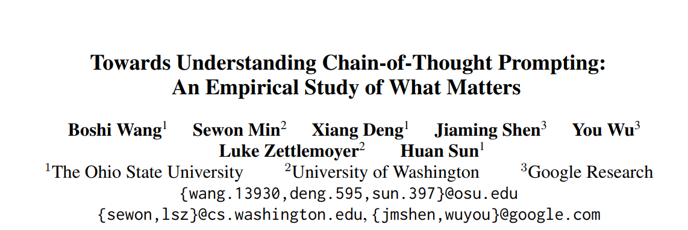
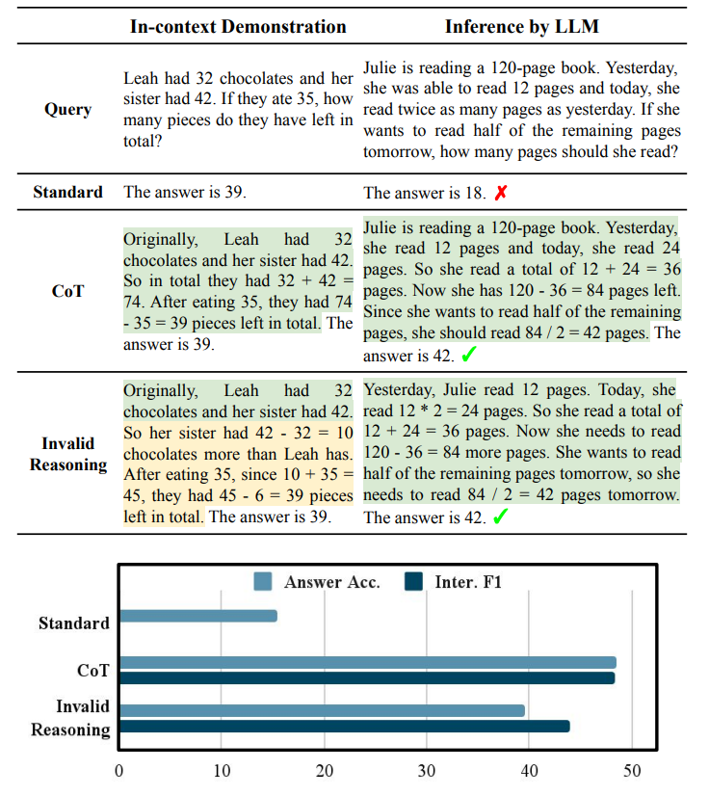
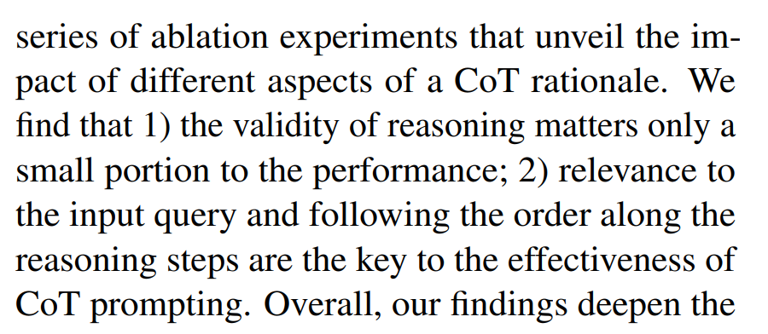
Why does Chain-of-Thought Prompting work?
Towards Understanding Chain-of-Thought Prompting: An Empirical Study of What Matters (Wang et al., Dec 2022)

Slide 25
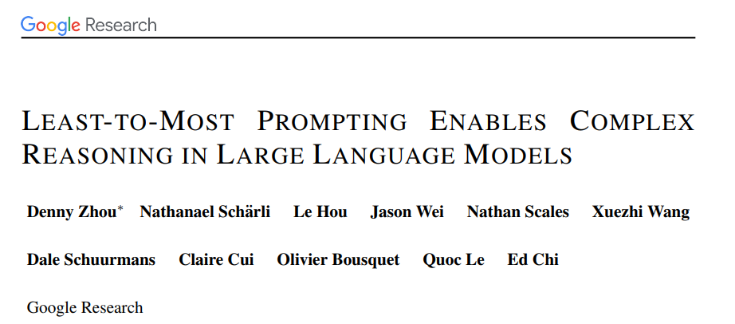
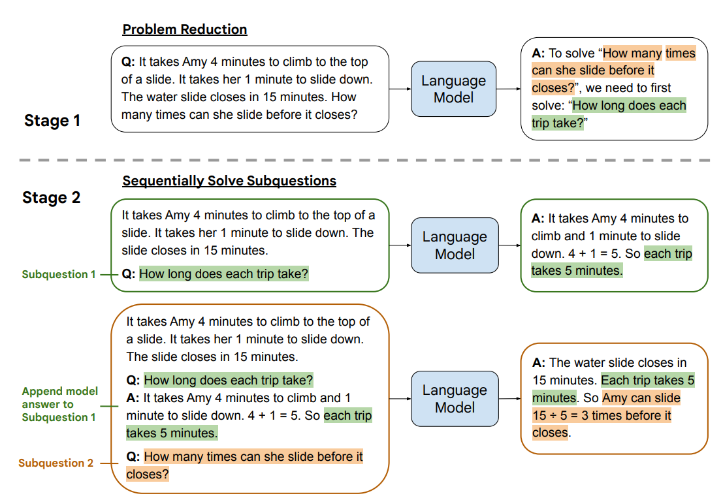
Least-to-Most Prompting
( Another variant of Chain-of-Thought Prompting )
Least-to-Most Prompting Enables Complex Reasoning in Large Language Models (2022, Zhou et al. (Google) )

Slide 26
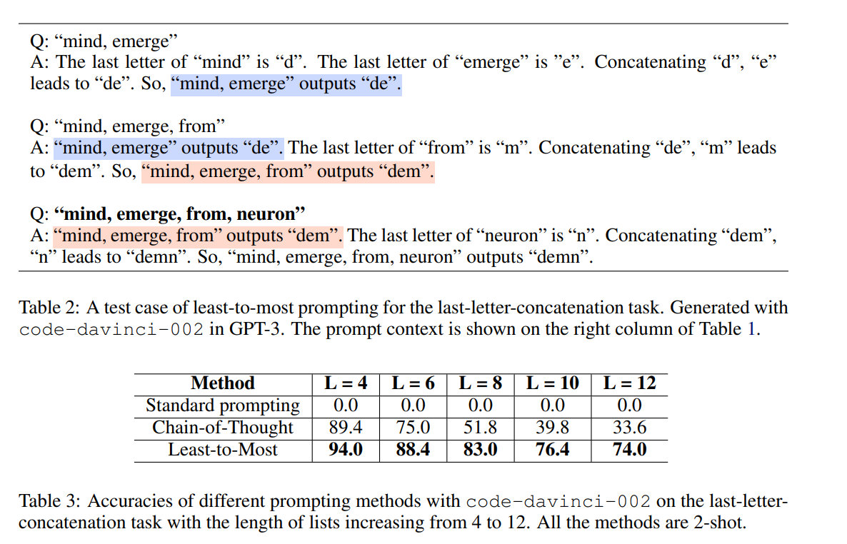
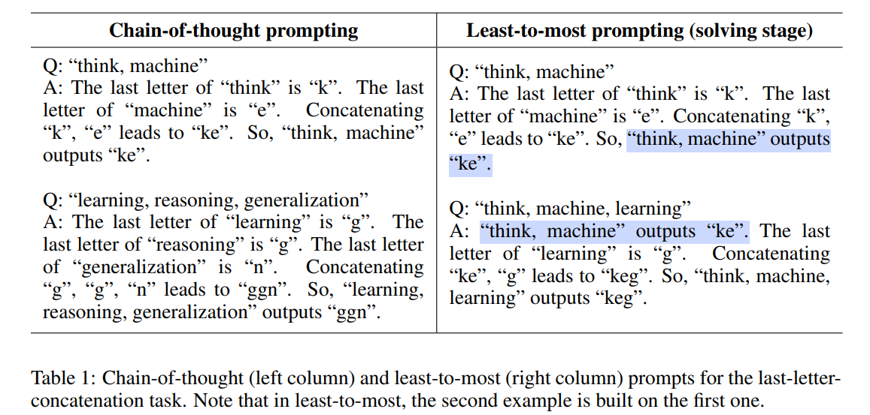
Least-to-Most Prompting
( Another variant of Chain-of-Thought Prompting )
Least-to-Most Prompting Enables Complex Reasoning in Large Language Models (2022, Zhou et al. (Google) )

Slide 27
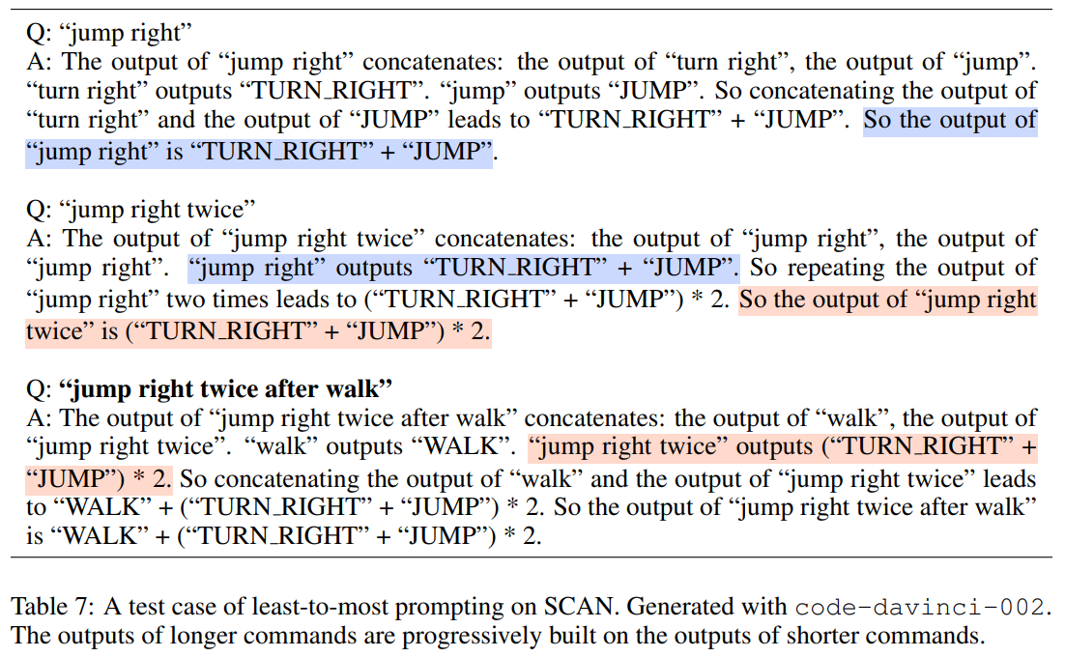
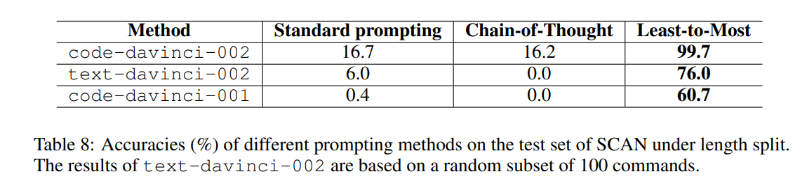
Least-to-Most Prompting
( Another variant of Chain-of-Thought Prompting )
Least-to-Most Prompting Enables Complex Reasoning in Large Language Models (2022, Zhou et al. (Google) )

Slide 28
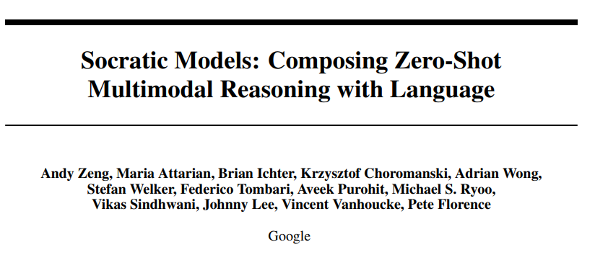
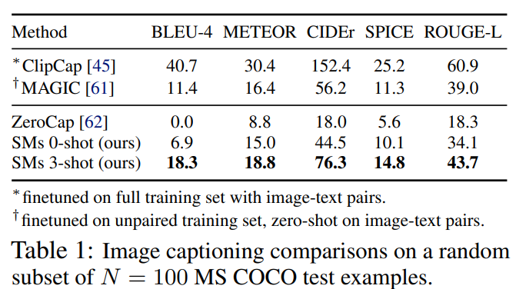
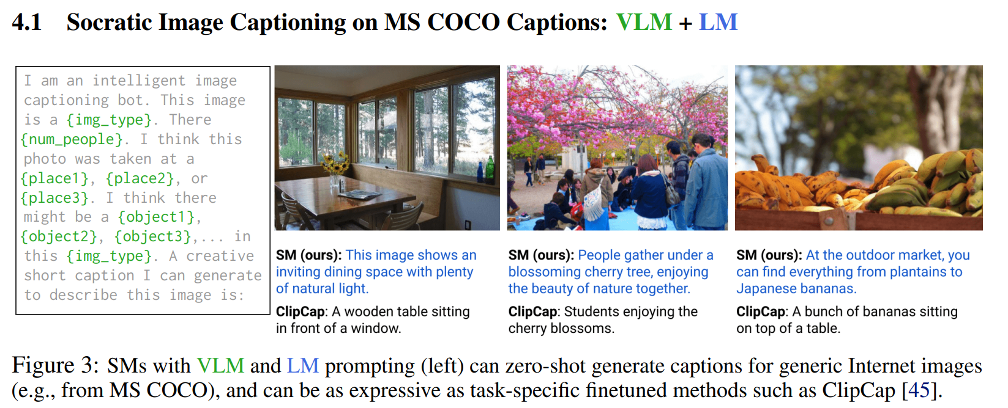
Prompting for Multimodal Reasoning
( Another variant of Prompting )
Socratic Models: Composing Zero-Shot Multimodal Reasoning with Language { 2022, Zeng et al. (Google) }

Slide 29
Limitations and Future Directions of Prompting
Limitations
Still in progress on understanding how/why it works, ( Can we predict whether in-context learning would work on a given task or not? )
Need to be cautious in evaluation
We have only scratched the surface of using prompts to improve model learning. Prompts will become more elaborate(= 더 자세히, 정교하게)!
Insights from @ACL22Tutorial

Slide 30
Limitations and Future Directions of Prompting
Future Directions
Better in-context learning
● Make it less sensitive to the order of training examples or patterns/verbalizers?
● It increases inference cost – how to make it efficient?
● How to scale it (longer context, more training examples)?
Better understanding
● Can we better understand how and why it works?
● Can we predict whether in-context learning would work on a given task or not?
Explainable NLP
Prompts may also be a more natural way to incorporate natural language explanations into model training.
Insights from @ACL22Tutorial

Slide 31
Thank you for your attention!

